Slide 1
Semaphore Implementation
The big problem with semaphores as described till now is the busy loop in the wait call, which consumes CPU cycles without doing any useful work. This type of lock is known as a spinlock
  An alternative approach:
  -Block a process if waiting and swap it out of the CPU.
  -Each semaphore needs to maintain a list of processes that are blocked waiting for it
  -One of the processes is woken up and swapped back when the semaphore becomes available.

Slide 2
Semaphore Implementation with no Busy waiting
With each semaphore there is an associated waiting queue. Each entry in a waiting queue has two data items:
  value (of type integer)
  pointer to next record in the list
Two operations :
  block – place the process invoking the operation on the appropriate waiting queue.
  wakeup – remove one of processes in the waiting queue and place it in the ready queue.

Slide 3
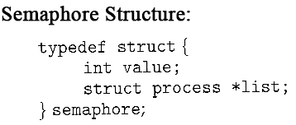
Semaphore Implementation with no Busy waiting (Cont.)
Implementation of wait:
wait (S){
value--;
if (value < 0) {
//add this process to queue
block(); }
}
Implementation of signal:
Signal (S){
value++;
if (value <= 0) {
//remove process P from the queue
wakeup(P); }
}
Value=1//available
Value<=0//in use so
wait in queue
The negative value indicates the number of processer waiting(exclude the one running)

Slide 4
Semaphore Implementation with no Busy waiting (Cont.)
Understanding Wait:
Say you have a printer
Value=1//available
First person to use printer will
Call wait(S) and value now becomes 0. However due to condition
If(value<0) block; the first user is not blocked and uses the printer.
Next user at the end of first line has value=-1 and is blocked.
Hence value =-x indicates that x ppl are waiting.
Vlue>=0 means currently no one is waiting
Implementation of wait:
wait (S){
value--;
if (value < 0) {
//add this process to queue
block(); }
}
Implementation of signal:
Signal (S){
value++;
if (value <= 0) {
//remove process P from the queue
wakeup(P); }
}

Slide 5
Classical Problems of Synchronization
Bounded-Buffer Problem
Readers and Writers Problem
Dining-Philosophers Problem

Slide 6
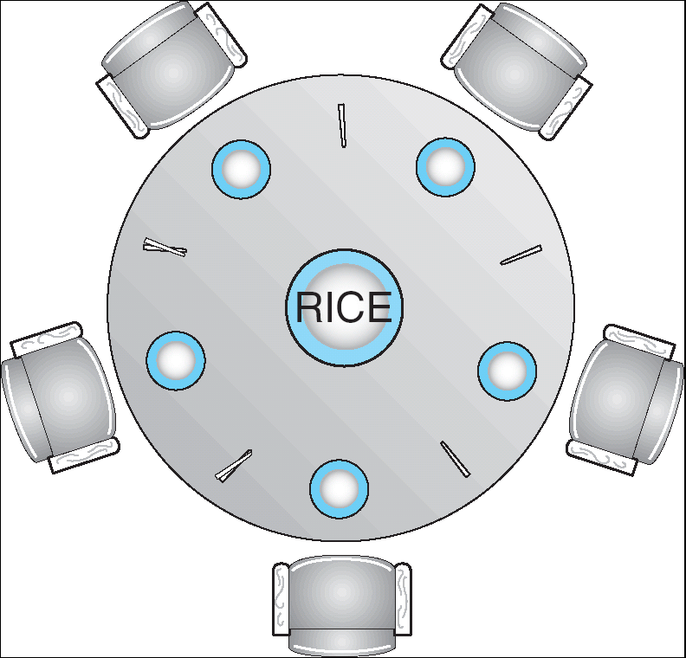
Dining-Philosophers Problem
Shared data
  Bowl of rice (data set)
  Semaphore chopstick [5] initialized to 1

Slide 7
Dining-Philosophers Problem (Cont.)
The structure of Philosopher i:
    Do {
    wait ( chopstick[i] );
    wait ( chopStick[ (i + 1) % 5] );
    // eat
    signal ( chopstick[i] );
    signal (chopstick[ (i + 1) % 5] );
    // think
    } while (true) ;

Slide 8
Dining-Philosophers Problem (Cont.)
The structure of Philosopher i:
    Do {
    wait ( chopstick[i] );
    wait ( chopStick[ (i + 1) % 5] );
    // eat
    signal ( chopstick[i] );
    signal (chopstick[ (i + 1) % 5] );
    // think
    } while (true) ;
Deadlock!- no progress
Each picks
Left fork at same time
And all wait forever

Slide 9
Conductor solution
do
{wait(mutex)
wait(i)
wait((i+1)%5)
signal(mutex)
//eat
signal(i)
signal((i+1)%5)
think
}while(true)

Slide 10
Conductor solution
do
{wait(mutex)
wait(i)
wait((i+1)%5)
signal(mutex)
//eat
signal(i)
signal((i+1)%5)
think
}while(true)
Lets say P1 got both his forks
and is eating.
P2 reaches step 3 after getting
one fork and is waiting for the other
which is being used by P1.
➔P2 is still inside the mutex lock
which does not permit P4 to request forks
though both his forks are idle.
Concurrent execution not
Possible due to mutex lock

Slide 11
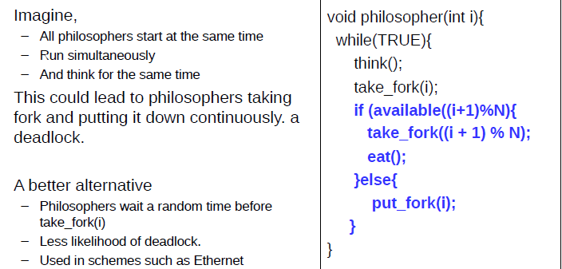
Move with precaution

Slide 12
Move with precaution
All pick fork together to realise other fork is not
available. So all put back fork together. This goes on.

Slide 13
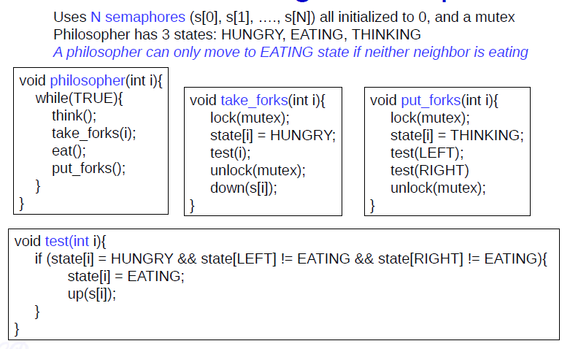
Tannenbaum solution

